Slide 1
Mapping the Knowledge Landscape of Design
Apurva Singhvi, Akansha Deshpande, Vinita Chakilam, Kartik Vegi, Pavan Jaggampudi

Slide 2
Goals
Understand how research in areas of design has changed over time
Identify the bursts of activity that happened in the last three decades
Understand the collaboration of networks over time
To map cluster of authors working on different topics, across topics and locations
To map design research topics and their interrelationships
To map geographic location of different research topics
To be able to map the design research by specific journal collections.
To map how much cross fertilization is taking place across these journals and domains.
Interactive visualizations which can be viewed through webpage with options for different possible lenses

Slide 3
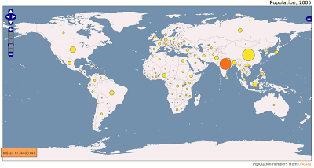
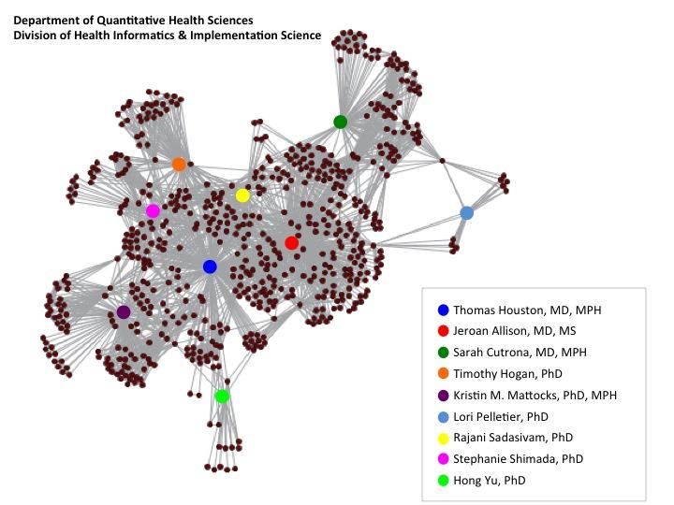
Envisioned Visualizations

Slide 4
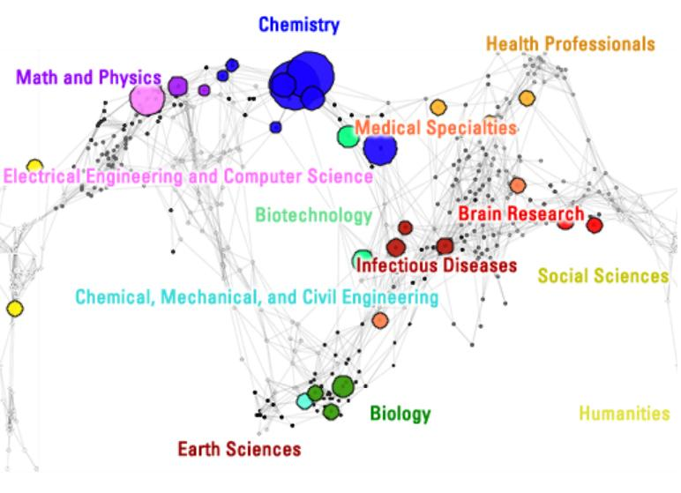
Envisioned Visualizations

Slide 5
Research for existing Visualizations
Reference Systems
World Map as reference systems
Use Map of Science as the existing reference system
Existing Visualizations
Proportional Symbol Map
Co Author Network
Burst Analysis
Tools
Tableau
Sci2
Gephi

Slide 6
Statistics of the data sets used
Publications are collected from 32 design journals - IUNI Web of Science dataset.
Total dataset size : 54110 records
Significant list of attributes :
WOS_ID (Unique Identifier)
Authors
Abstracts
Cited references
Count of cited references
No. of times cited
Document Type
Publication type
Journal Name
Language
Publisher
Publication date
Publisher address
Researcher id
Research address

Slide 7
Algorithms
Burst Algorithm
Author Co occurrence network
Proportional Symbol Map for number of researches on world map

Slide 8
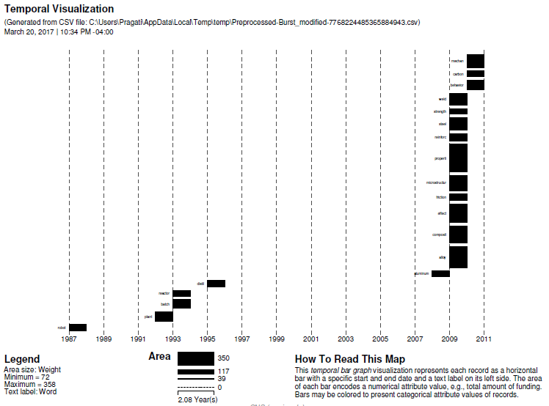
Resulting Visualization (Burst Analysis)

Slide 9
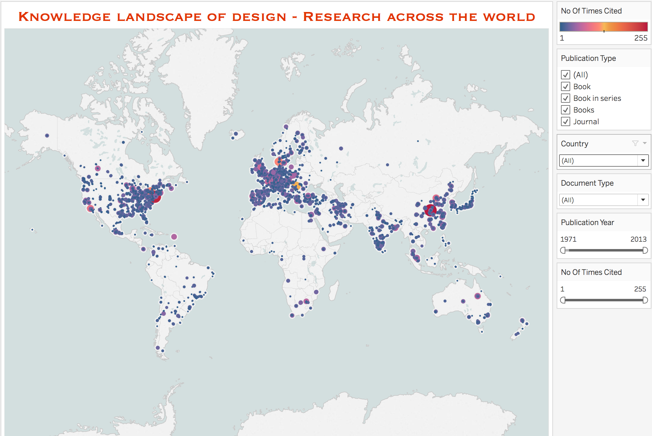
Resulting Visualization (Dynamic Proportional Symbol Map using Tableau)
Link: https://public.tableau.com/profile/karthikvegi - !/vizhome/knowledge-landscape/geospatial

Slide 10
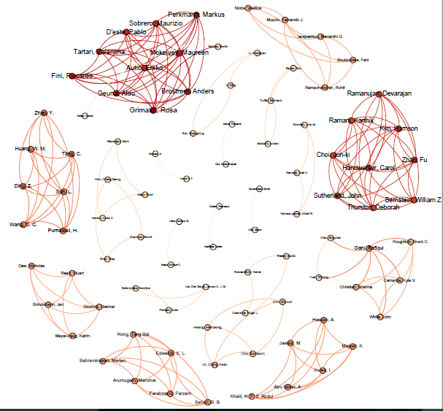
Resulting Visualizations (Co Author Network)

Slide 11
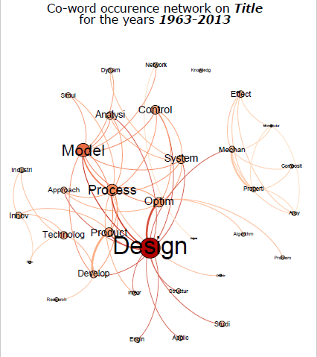
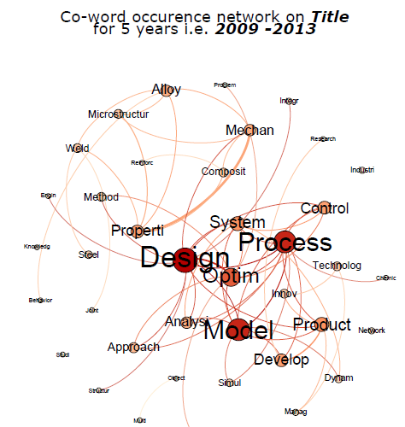
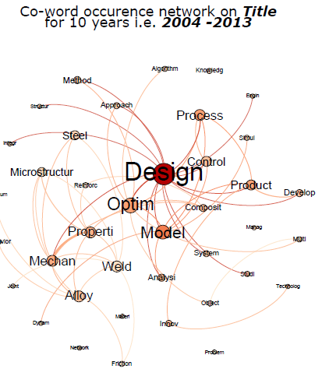
Co-Word Network (Entire Data Set)

Slide 12
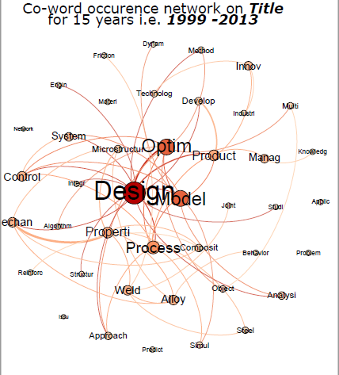
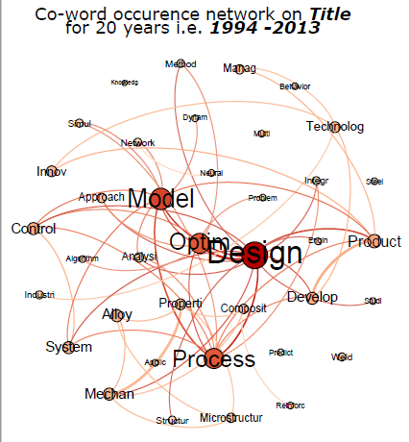
Co-Word Network (Entire Data Set)

Slide 13
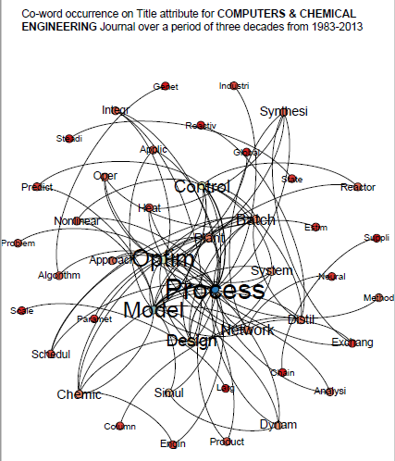
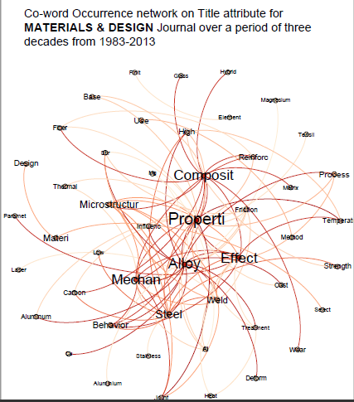
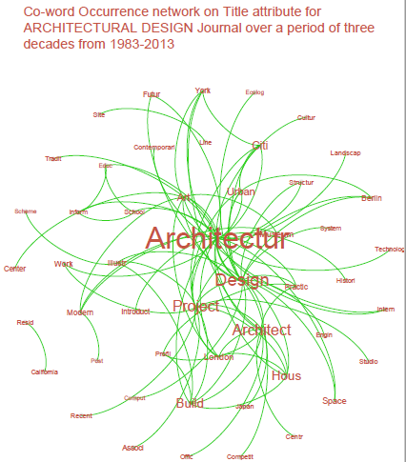
Co-Word Network (Based on top 3 Journals)

Slide 14
Insights from Visualizations
Burst analysis has given a change of design landscape from the last three decades from robotics in 1987 to carbon recently
Co word network has shown a strong correlation between design, process, model, product and optimization
Proportional symbol map has shown a good amount of research done in USA and Germany in Europe. Dynamic visualization provided the research done in different lenses

Slide 15
Challenges
Data cleansing
Unique Identifier is null
Duplicate records
Title contains numbers
Removing the noise words like ‘New’, ’Paper’ while making word occurrence network
File Loading Issues
Not enough Heap space (87 MB)
File Format (IUNI Dataset)

Slide 16
References
Proportional Symbol Map. Retrived from http://blog.mastermaps.com/2008/04/proportional-symbol-mapping-with.html
Map of Science. Retrived from https://sciencenode.org/visualization/mapping-publications-science.php
Sci2 Team. (2009). Science of Science (Sci2) Tool. Indiana University and SciTech Strategies, http://sci2.cns.iu.edu

